Slide 1
INTERNATIONAL FOLK DANCE

Slide 2
Definition: Traditional dances that originate from the customs and culture of different countries of ethnic groups. Often performed during festivals, rituals, or community events.
History: Folkdance has ancient roots, often tied to daily life, agricultural traditions, and religious celebrations. Each region developed its unique styles, music, and costumes to reflect local values and stories, overtime, many were formalized and shared globally through cultural change.

Slide 3
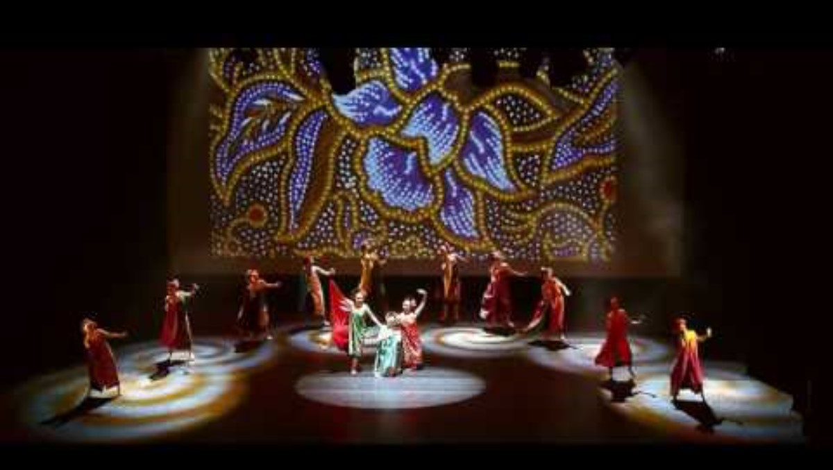
International folkdance

Slide 4
FOXTROT

Slide 5
Definition: A smooth, progressive dance characterized by long, flowing steps and a graceful rise-and-full motion.
History: Originated in the U.S. around 1914, named after entertainer Harry fox. It became popular in ballrooms due to its elegant style and adaptability to big band music.

Slide 6
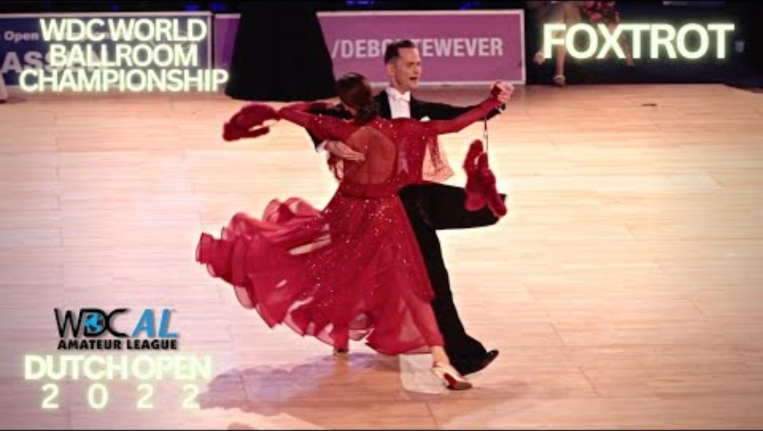
FOXTROT

Slide 7
CHA-CHA

Slide 8
Definition: A lively Latin dance marked by quick steps and a syncopated rhythm specially the “cha-cha” step.
History: Originated in Cuba in the 1950s as a slower version of the mambo. It quickly gained popularity in ballroom dance circles for its fun, flirty style.

Slide 9
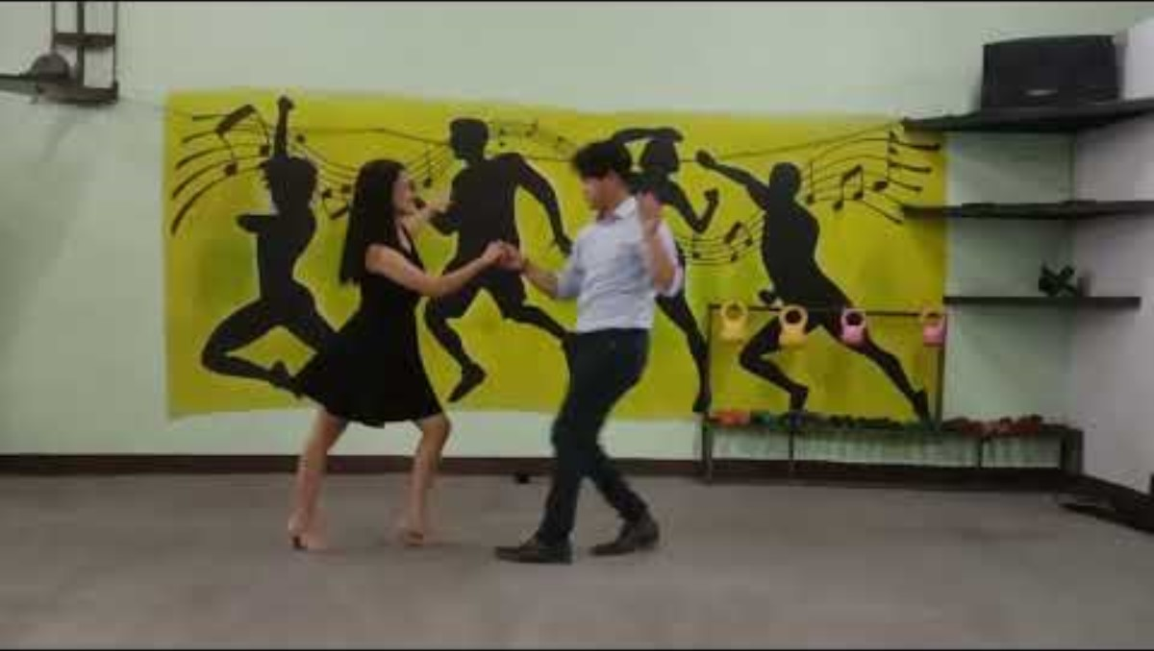
CHA-CHA

Slide 10
SWING

Slide 11
Definition: A group of energetic dances that feature lively footwork, spins, and lifts, typically performed to jazz or swing music.
History: Developed in the U.S. in the 1920s-1940s, especially among African-American communities, Styles include Lindy Hop, East Coast Swing, and West Coast Swing.

Slide 12
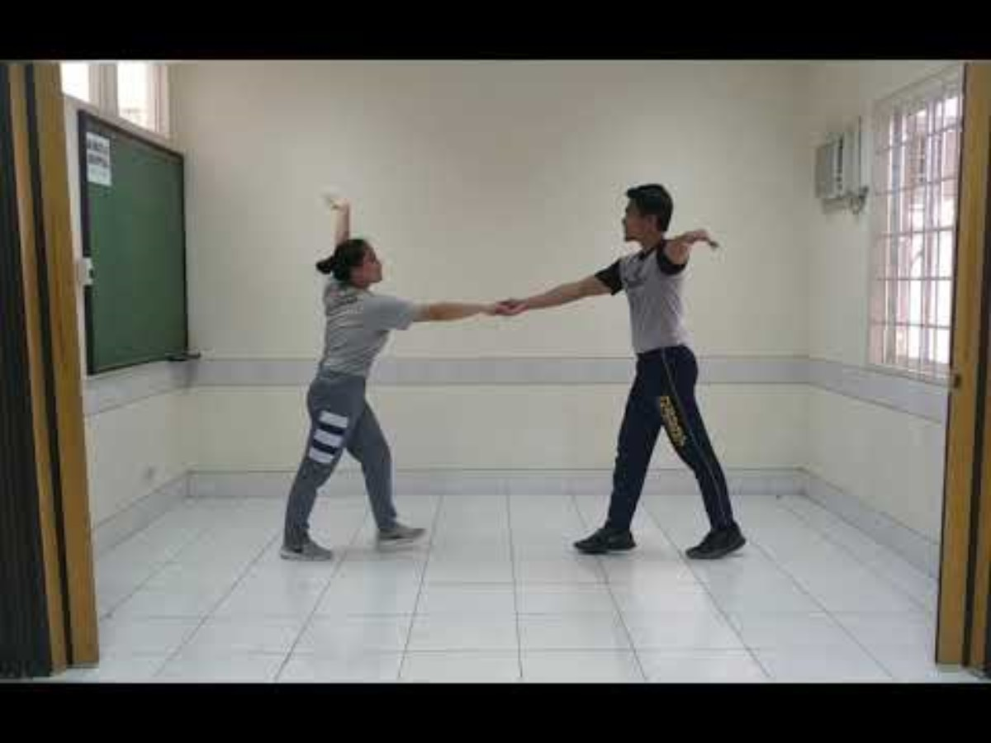
Swing dance

Slide 13
RUMBA

Slide 14
Definition: A slow, romantic Latin dance with a rhythmic hip motion and intimate movements.
History: Rooted in Cuban music and dance, rumba evolved from afro-Cuban traditions and became popular internationally in the early 20th century. It was formalized into ballroom dance styles later on.

Slide 15
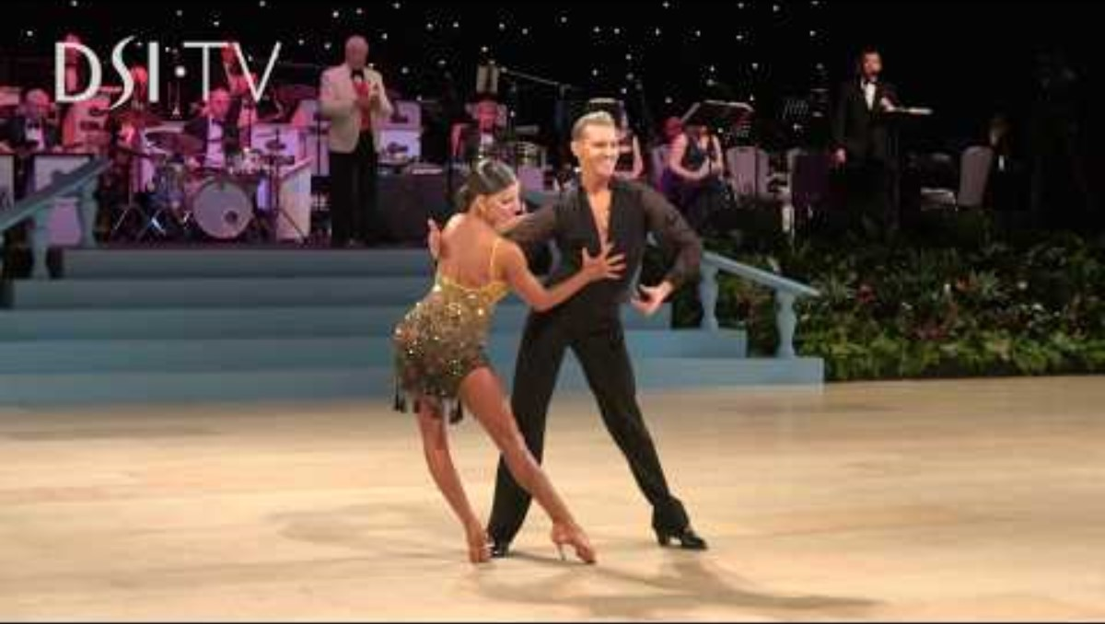
Rumba dance

Slide 16
JIVE

Slide 17
Definition: A fast-paced, upbeat dance characterized by kicks, flicks, and energetic bouncing.
History: Originated in the U.S. in the 1930s from swing dance. It became part of ballroom competitions in the1960s and is know for its athletic and vibrant style.

Slide 18

Jive dance

Slide 19
WALTZ

Slide 20
Definition: A graceful dance performed in ¾ time, featuring a smooth, gliding motion and turning steps.
History: Originated in Austria and Germany in the late 18th century. Initially controversial due to the close hold between partners, it eventually became a ballroom favorite across Europe.

Slide 21
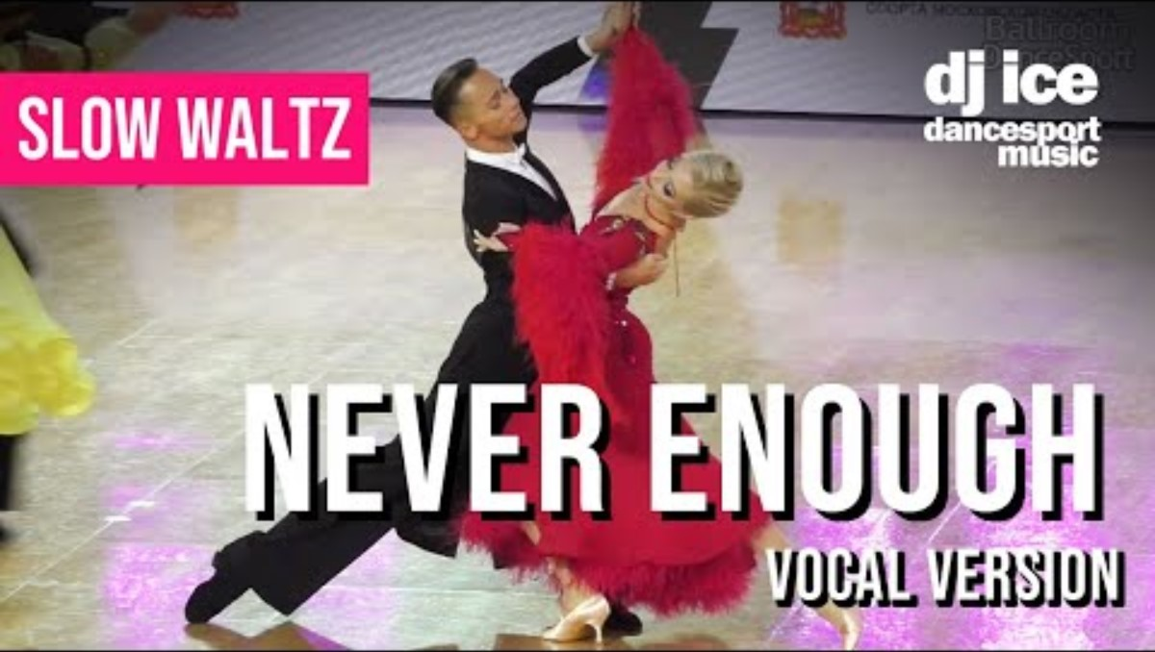
Waltz dance

Slide 22
TANGO

Slide 23
Definition: A passionate, dramatic dance know for sharp movements, close embrace, and expressive gestures.
History: Emerged in the late 1800s in Buenos Aires, Argentina, in working-class neighborhoods. Influenced by European, African, and native cultures, it evolved into an iconic ballroom and social dance.

Slide 24
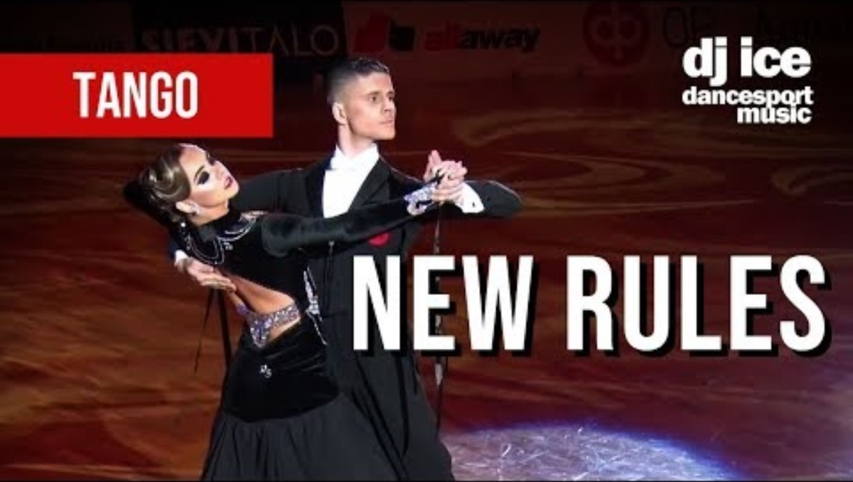
Tango dance

